Slide 1

Machine Learning
Data Analysis
Workshop
Ömer Faruk Öztemiz
Data Engineer
Notes:
responsible for net lift, or we work on something else

Slide 2
What is Data Science?
Data science is a systematic study of
generalizable extraction of knowledge from data
Notes:
What is data science? Definition - >Tweet

Slide 3
PROBLEMS
We need to parallelize data operations but it’s too costly & complex ...
The business can’t get access to all the relevant data, we need external data...
We can’t match customer master data to live customer interactions...
We can’t just force everything into a star-schema...
These BI reports and charts don’t tell us anything we didn’t know...
We are missing the ETL window, the data we needed didn’t arrive on time...
We can’t predict with confidence if we can’t explore data & develop our own models
Notes:
Problems -> solution? Amdahls law paralellization

Slide 4
Big Data is not about Data Volume
Notes:
-> n V’s

Slide 5
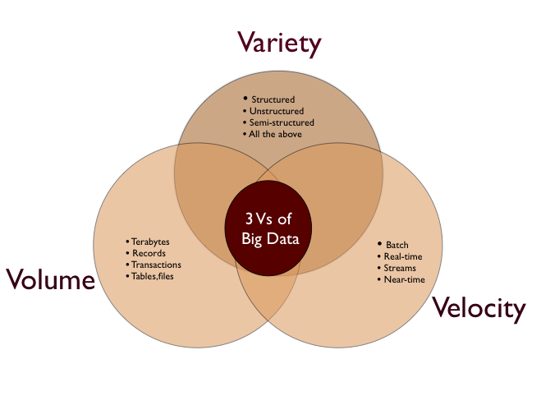
What is Big Data? The n-Vs
Notes:
Vol – variety video, sound,image->CAP theorem

Slide 6
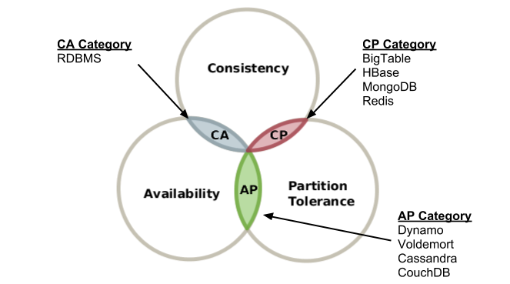
CAP THEOREM
it is impossible for a distributed computer system to simultaneously provide all three of the following guarantees -Eric Brewer
Consistency (all nodes see the same data at the same time)
Availability (a guarantee that every request receives a response about whether it succeeded or failed)
Partition tolerance (the system continues to operate despite arbitrary partitioning due to network failures)
Source:wikipedia
Notes:
Problems for distributed computer systems->big data forces you

Slide 7
Big Data forces you to change the way you
collect, store, manage, analyze and visualize data
Notes:
-> big data = crude oil

Slide 8
Knowns & Unknowns
There are known knowns. These are things we know that we know.
There are known unknowns. That is to say, there are things that we know we don't know.
But there are also unknown unknowns. There are things we don't know we don't know
Donald Rumsfeld
Notes:
Rumsfeld 2002 press conf->the science of discovering what we dont know about data

Slide 9
The Science of…
Discovering what we don’t know from data
Obtaining predictive, actionable insight from data
Creating Data Products that have business impact now
Communicating relevant business stories from data
Building confidence in decisions that drive business value
Notes:
-> diff from bi whats different from data analysis

Slide 10
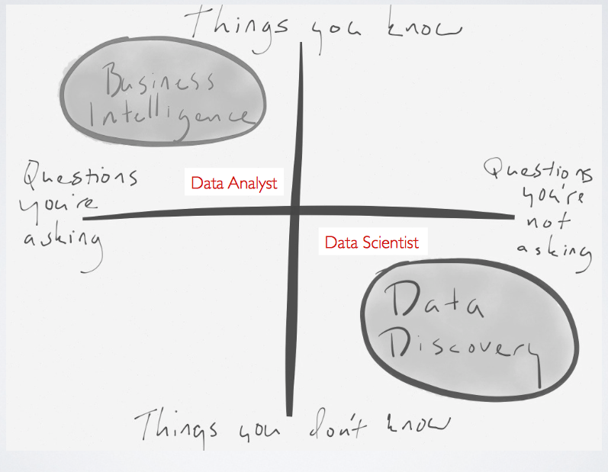
Notes:
-> venn diagram -skills

Slide 11
Most valuable skills
learn to use programmable tools that prepare data
learn to generate compelling data visualizations
learn to estimate the confidence for reported results
learn to automate work, making analysis repeatable
Notes:
-> tools Python vs R

Slide 12
https://github.com/omarozt/workshop

Slide 13
Linear regression
Given an input x we would like to compute an output y
In linear regression we assume that y and x are related with the following equation:
y = wx+ε
where w is a parameter and ε represents measurement or other noise
Y
Observed values
What we are trying to predict
X

Slide 14
Linear Regression
Linear regression: involves a response variable y and a single predictor variable x → y = w₀ + w₁ x
The weights w₀ (y-intercept) and w₁ (slope) are regression coefficients
Method of least squares: estimates the best-fitting straight line
w₀ and w₁ are obtained by minimizing the sum of the squared errors (a.k.a. residuals)
w₁ can be obtained by setting the partial derivative of the SSE to 0 and solving for w₁, ultimately resulting in:

Slide 15
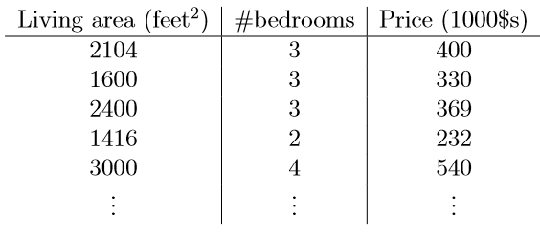
Multiple Linear Regression
Multiple linear regression: involves more than one predictor variable
Features represented as x₁, x₂, …, x_{d}
Training data is of the form (x¹, y¹), (x², y²),…, (x^{n}, y^{n}) (each x^{j} is a row vector in matrix X, i.e. a row in the data)
For a specific value of a feature x_{i} in data item x^{j} we use:
Ex. For 2-D data, the regression function is:
More generally:
x₁
x₂
y

Slide 16
Least Squares Generalization
Multiple dimensions
To simplify add a new feature x₀ = 1 to feature vector x:
1 1 1 1 1

Slide 17
Least Squares Generalization
Calculate the error function (SSE) and determine w:
Closed form solution to

Slide 18
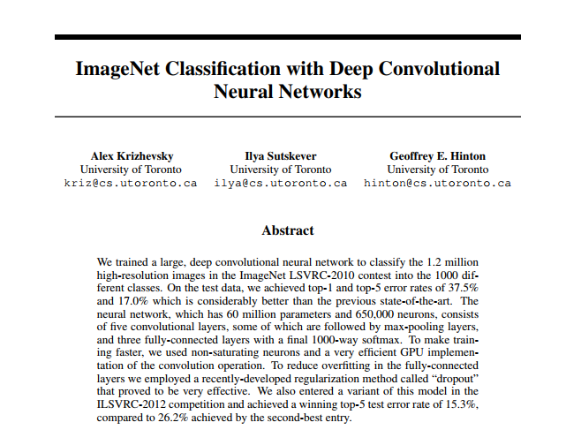
Good luck!
https://www.nvidia.cn/content/tesla/pdf/machine-learning/imagenet-classification-with-deep-convolutional-nn.pdf

Slide 19
Optimization
Gradient is a vector
Each element is the slope of function along direction of one of variables
Each element is the partial derivative of function with respect to one of variables
Example:

Slide 20
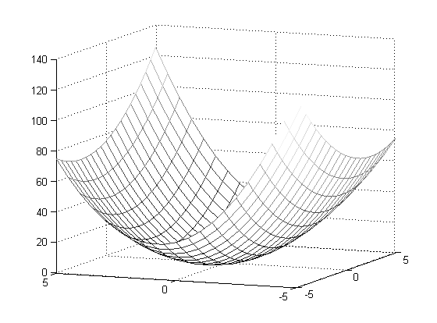
Optimization
Gradient vector points in direction of steepest ascent of function

Slide 21
Optimization
An example - quadratic function in 2 variables:
f( x ) = f( x₁, x₂ ) = x₁² + x₁x₂ + 3x₂²
f( x ) is minimum where gradient of f( x ) is zero in all directions

Slide 22
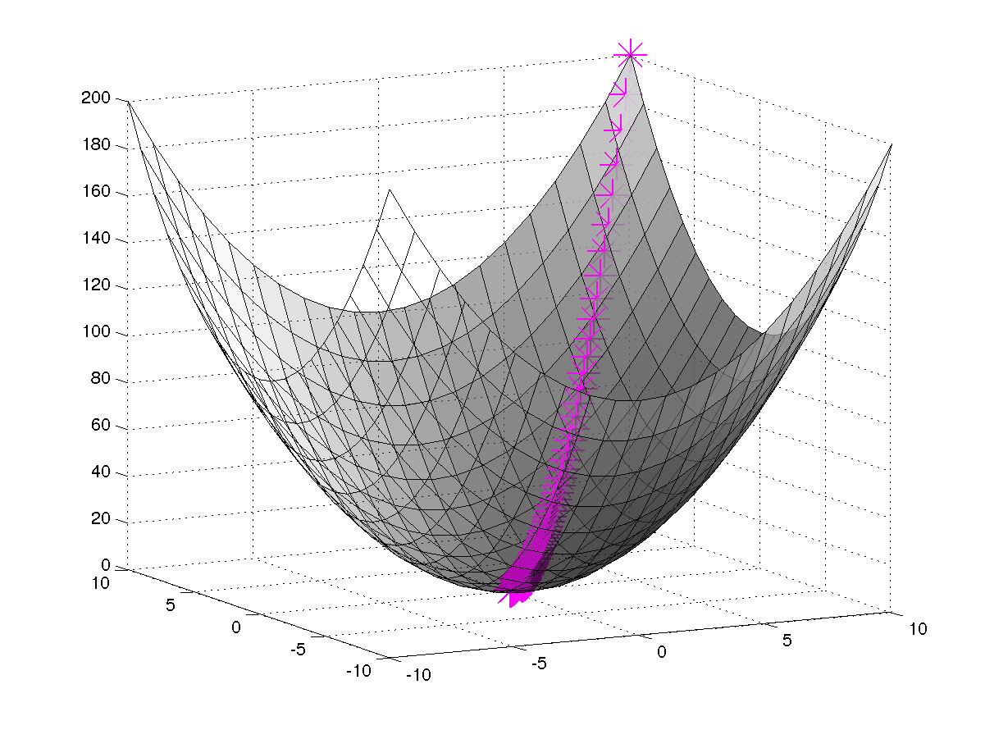
Gradient Descent
In order to apply GD to Linear Regression all we need is the gradient of the objective function (i.e. vector of partial derivatives).

Slide 23
Gradient Descent
There are many possible ways to detect convergence. For example, we could check whether the L2 norm of the gradient is below some small tolerance.
Alternatively we could check that the reduction in the objective function from one iteration to the next is small.

Slide 24
Illustration of Gradient Descent
E(w)
w₁
w₀

Slide 25
Illustration of Gradient Descent
E(w)
w₁
w₀

Slide 26
Illustration of Gradient Descent
E(w)
w₁
Direction of steepest
descent = direction of
negative gradient
w₀

Slide 27
Illustration of Gradient Descent
E(w)
w₁
Original point in
weight space
New point in
weight space
w₀

Slide 28

Gradient descent optimization
Problems:
Choosing step size (learning rate)
too small → convergence is slow and inefficient
too large → may not converge
Can get stuck on “flat” areas of function
Easily trapped in local minima

Slide 29
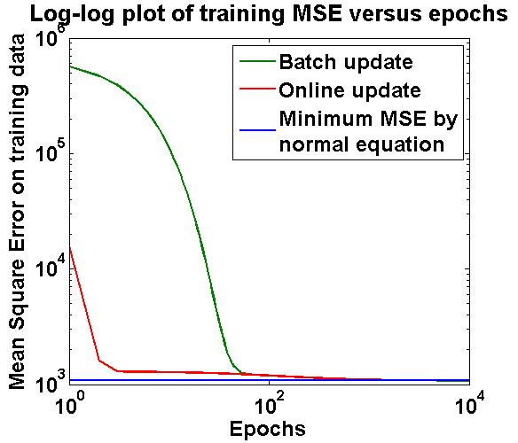
Convergence Curves
For the batch method, the training MSE is initially large due to uninformed initialization
In the online update, N updates for every epoch reduces MSE to a much smaller value.

Slide 30
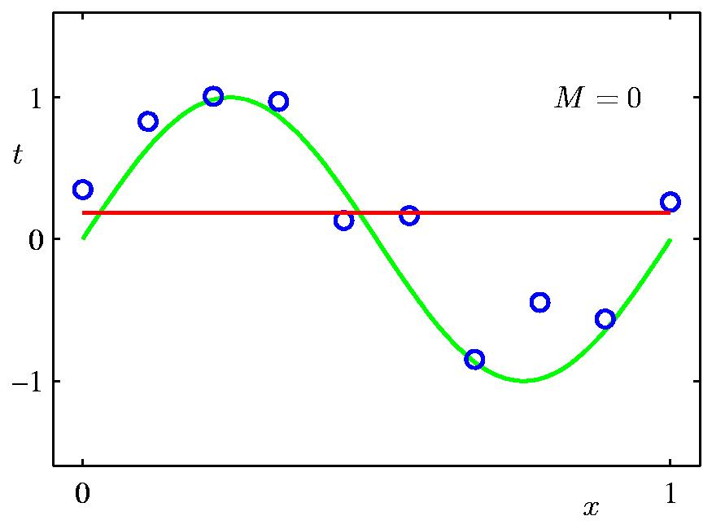
0th Order Polynomial
n=10

Slide 31
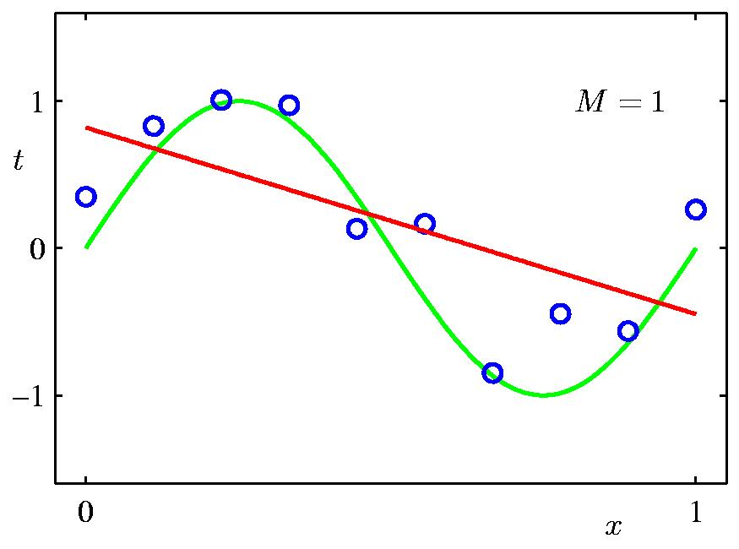
1st Order Polynomial

Slide 32
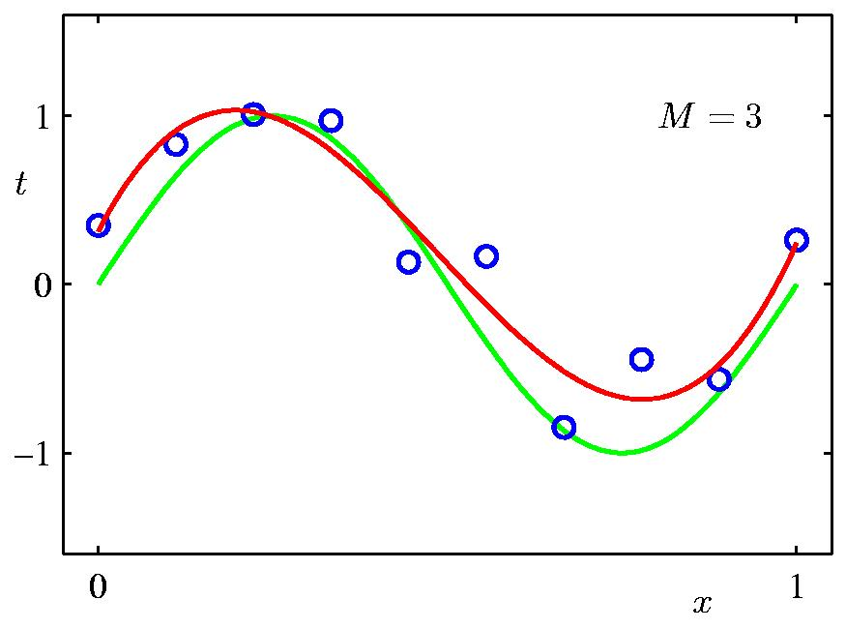
3rd Order Polynomial

Slide 33
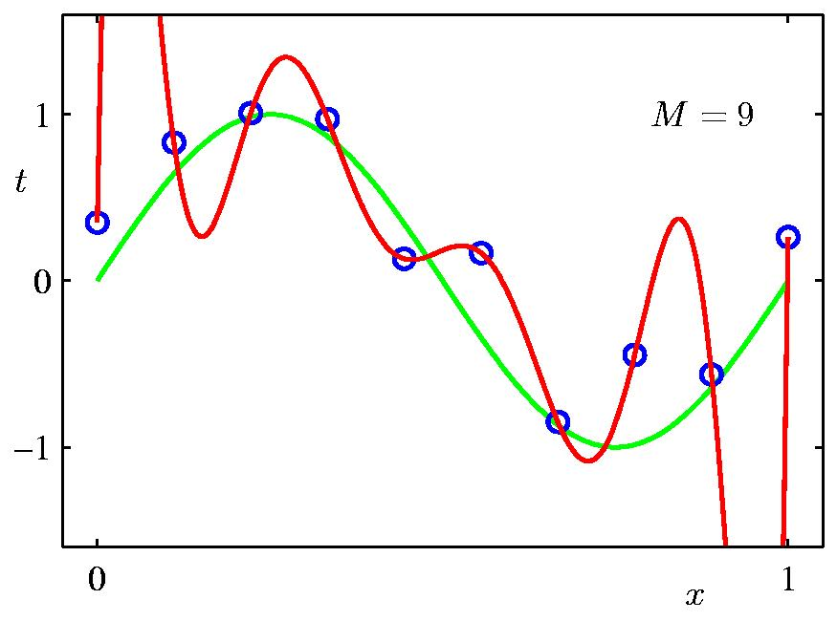
9th Order Polynomial

Slide 34
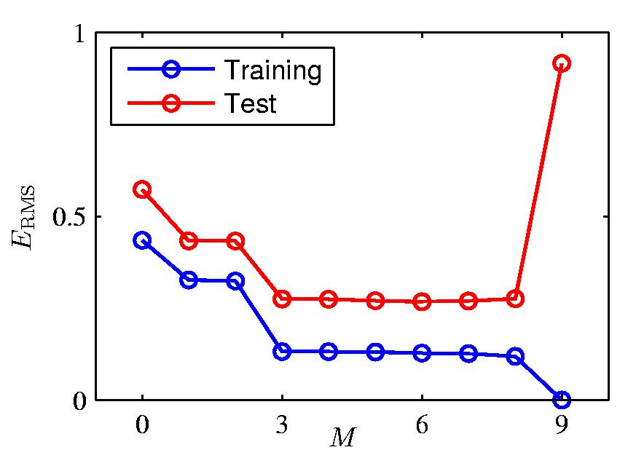
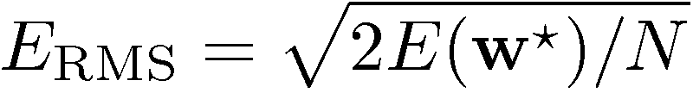
Over-fitting
Root-Mean-Square (RMS) Error:

Slide 35
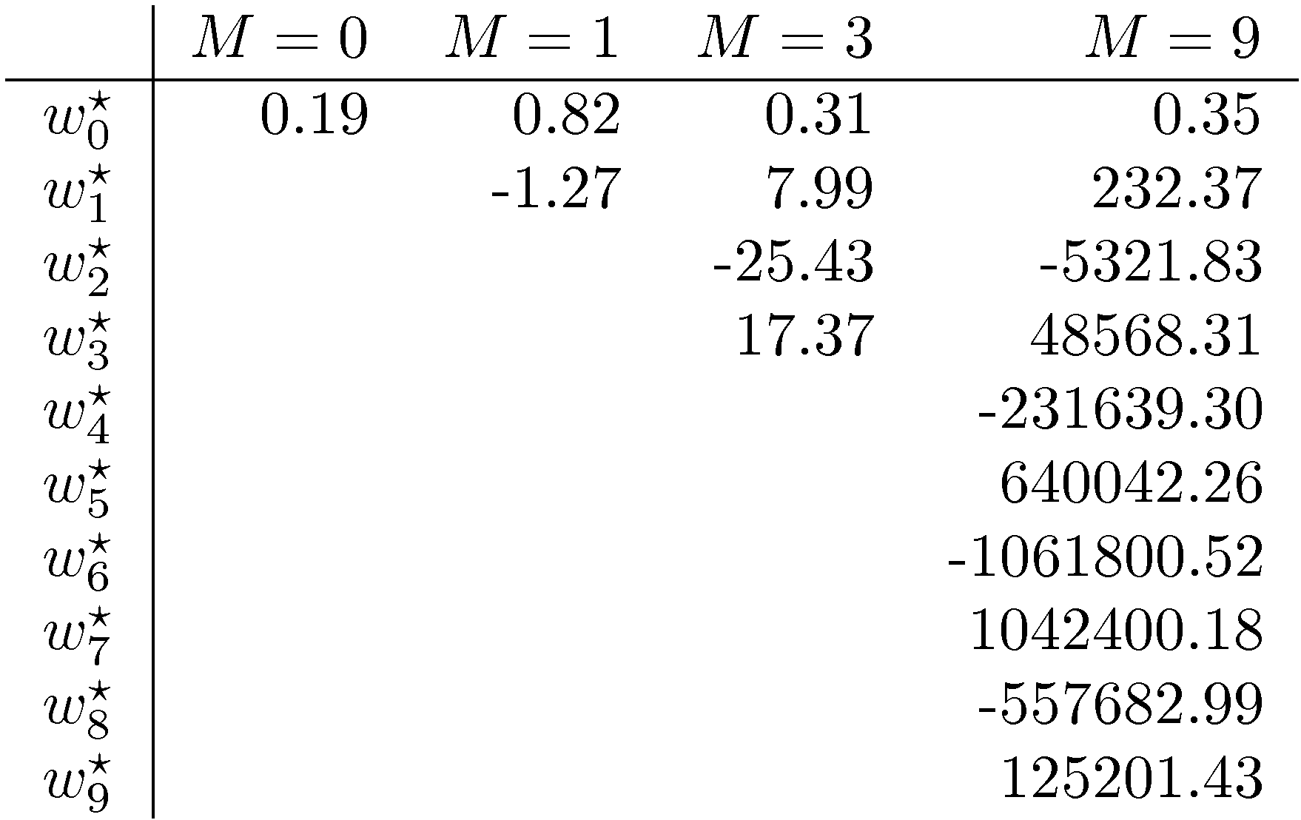
Polynomial Coefficients

Slide 36
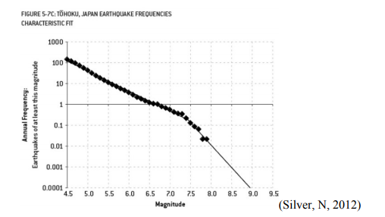
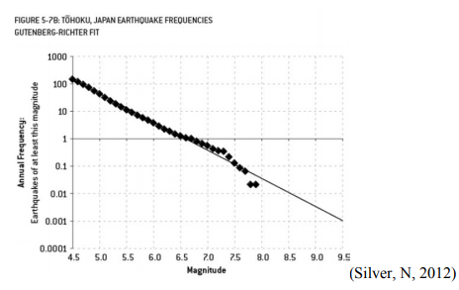
Fukushima: The Failure of Predictive Models by Brian Stacey Southern New Hampshire University ,1 April 2015
The plant was designed to withstand a maximum earthquake of 8.6 magnitude, and a tsunami as high as 5.7 meters
The earthquake on March 11, 2011 measured 9.0 and resulted in a >14 meter high tsunami.
a magnitude 9 earthquake is about 70 times more likely than predicted
https://mpra.ub.uni-muenchen.de/69383/1/MPRA_paper_69383.pdf

Slide 37
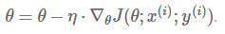
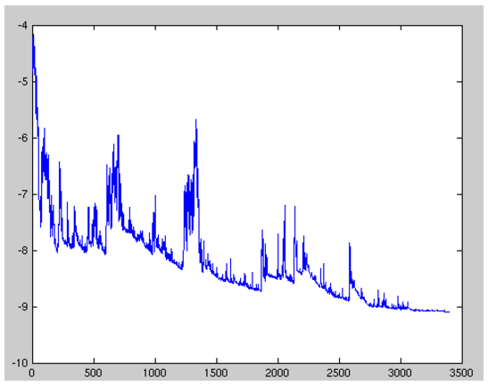
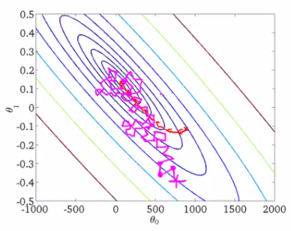
Stochastic gradient descent
Batch gradient descent
Vanilla gradient descent, aka batch gradient descent, computes the gradient of the cost function w.r.t. to the parameters θθ for the entire training dataset:
for i in range(nb_epochs):
params_grad = evaluate_gradient(loss_function, data, params)
params = params - learning_rate * params_grad
Stochastic gradient descent
Stochastic gradient descent (SGD) in contrast performs a parameter update for each training example
for i in range(nb_epochs):
np.random.shuffle(data)
for example in data:
params_grad = evaluate_gradient(loss_function, example, params)
params = params - learning_rate * params_grad
Best of batch and stochastic ?

Slide 38
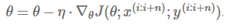
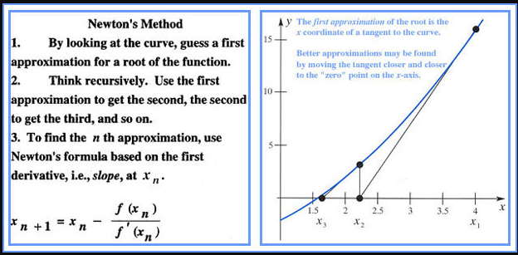
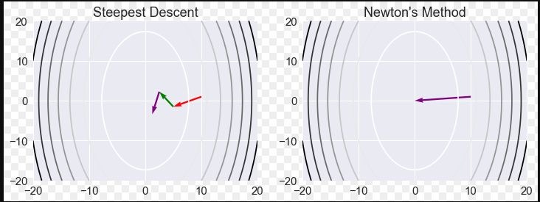
Mini batch gradient descent
Mini-batch gradient descent
Mini-batch gradient descent finally takes the best of both worlds and performs an update for every mini-batch of n training examples:
for i in range(nb_epochs):
np.random.shuffle(data)
for batch in get_batches(data, batch_size=50):
params_grad = evaluate_gradient(loss_function, batch, params)
params = params - learning_rate * params_grad
Choosing a proper learning rate ?
Newton’s Method?

Slide 39
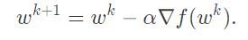
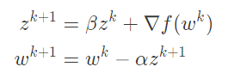
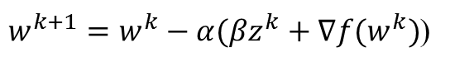
Momentum
We give gradient descent a short-term memory:
Gradient descent
tweak
$w^{k+1}=w^{k}−α(βz^{k}+∇f(w^{k})$)
Final form
https://distill.pub/2017/momentum/

Slide 40
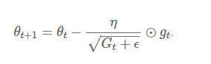
ADAGRAD
adapts the learning rate to the parameters, performing larger updates for infrequent and smaller updates for frequent parameters
One of Adagrad's main benefits is that it eliminates the need to manually tune the learning rate.
After some time, learning rate goes to very small values
http://ruder.io/optimizing-gradient-descent/index.html#hogwild

Slide 41
ADADELTA
Adadelta [6] is an extension of Adagrad that seeks to reduce its aggressive, monotonically decreasing learning rate. Instead of accumulating all past squared gradients, Adadelta restricts the window of accumulated past gradients to some fixed size w.
Adaptive moment estimation
ADAM

Slide 42
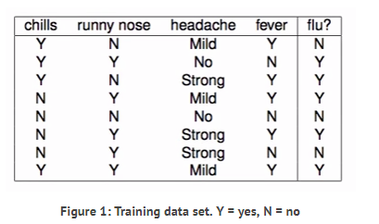
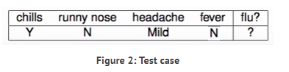
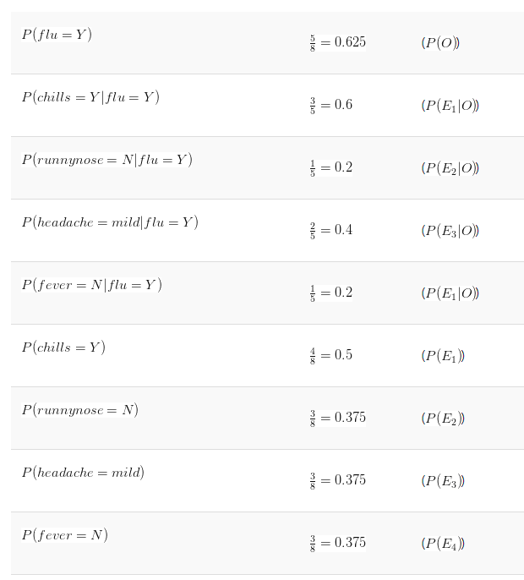
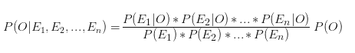
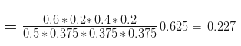
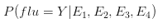
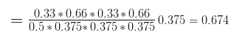
Bayes Classifier = NO

Slide 43
Full Gradient Descent Illustration
Notes:
Elipses are level curves (function is quadratic). If we start on ---- line –gradient goes towards minimum (middle), if not, bounce back and forth

Slide 44

Classification
Logistic
Regression
Machine Learning

Slide 45
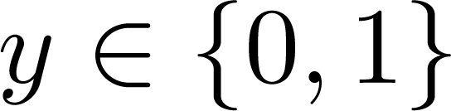
Classification
Email: Spam / Not Spam?
Online Transactions: Fraudulent (Yes / No)?
Tumor: Malignant / Benign ?
0: “Negative Class” (e.g., benign tumor)
1: “Positive Class” (e.g., malignant tumor)

Slide 46
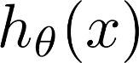
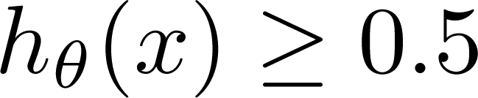
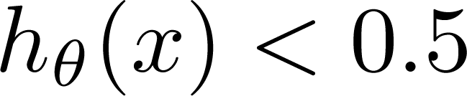
(Yes) 1
Malignant ?
(No) 0
Tumor Size
Tumor Size
Threshold classifier output at 0.5:
If , predict “y = 1”
If , predict “y = 0”

Slide 47
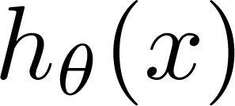
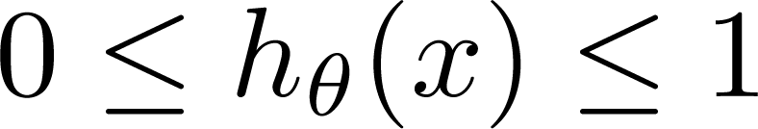
Classification: y = 0 or 1
can be > 1 or < 0
Logistic Regression:

Slide 48
Hypothesis Representation
Logistic
Regression
Machine Learning

Slide 49
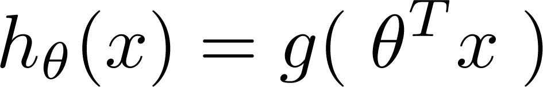
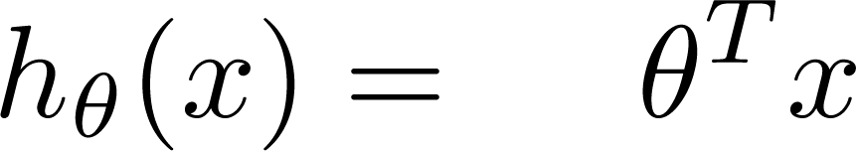
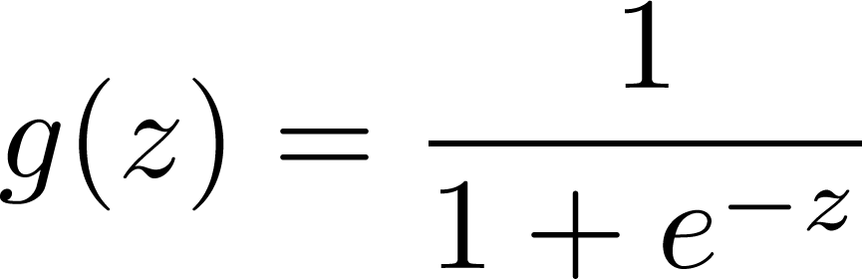
Logistic Regression Model
Want
1
0.5
Sigmoid function
Logistic function
0

Slide 50
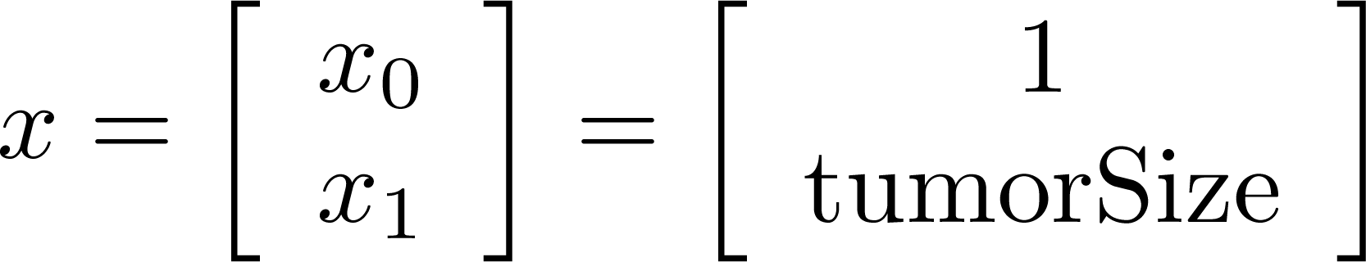
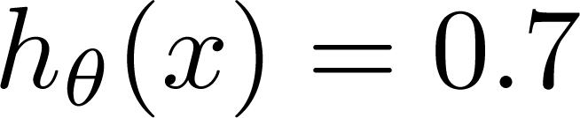
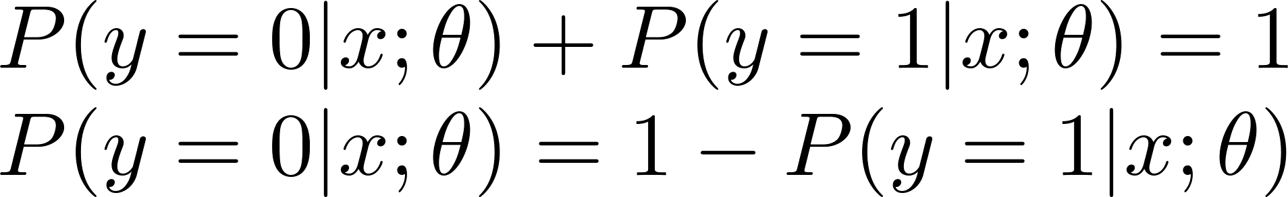
Interpretation of Hypothesis Output
= estimated probability that y = 1 on input x
Example: If
Tell patient that 70% chance of tumor being malignant
“probability that y = 1, given x,
parameterized by ”

Slide 51
Decision boundary
Logistic
Regression
Machine Learning

Slide 52
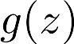
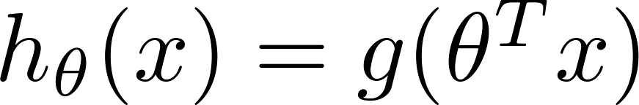
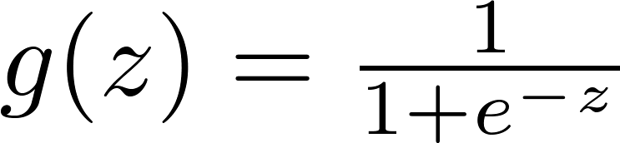
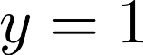



Logistic regression
1
z
Suppose predict “ “ if
predict “ “ if

Slide 53


Decision Boundary
x₂
3
2
1
1
2
3
x₁
Predict “ “ if

Slide 54


Non-linear decision boundaries
x₂
1
x₁
-1
1
-1
Predict “ “ if
x₂
x₁

Slide 55
Cost function
Logistic
Regression
Machine Learning

Slide 56




Training set:
m examples
How to choose parameters ?

Slide 57


Cost function
Linear regression:
“non-convex”
“convex”

Slide 58


Logistic regression cost function
If y = 1
0
1

Slide 59
Logistic regression cost function
If y = 0
0
1

Slide 60
Simplified cost function and gradient descent
Logistic
Regression
Machine Learning

Slide 61

Logistic regression cost function

Slide 62




Logistic regression cost function
To fit parameters :
To make a prediction given new :
Output

Slide 63





Gradient Descent
Want :
Repeat
(simultaneously update all )

Slide 64

Gradient Descent
Want :
Repeat
(simultaneously update all )
Algorithm looks identical to linear regression!

Slide 65
Advanced optimization
Logistic
Regression
Machine Learning

Slide 66



Optimization algorithm
Cost function . Want .
Given , we have code that can compute
(for )
Gradient descent:
Repeat

Slide 67

Optimization algorithm
Given , we have code that can compute
(for )
Optimization algorithms:
Gradient descent
Advantages:
No need to manually pick
Often faster than gradient descent.
Disadvantages:
More complex
Conjugate gradient
BFGS
L-BFGS

Slide 68



Example:
function [jVal, gradient] = costFunction(theta)
jVal = (theta(1)-5)^2 + ... (theta(2)-5)^2;
gradient = zeros(2,1);
gradient(1) = 2*(theta(1)-5); gradient(2) = 2*(theta(2)-5);
options = optimset(‘GradObj’, ‘on’, ‘MaxIter’, ‘100’);
initialTheta = zeros(2,1); [optTheta, functionVal, exitFlag] ...
= fminunc(@costFunction, initialTheta, options);

Slide 69




theta =
function [jVal, gradient] = costFunction(theta)
code to compute
jVal = [ ];
code to compute
gradient(1) = [ ];
code to compute
gradient(2) = [ ];
code to compute
gradient(n+1) = [ ];

Slide 70
Multi-class classification: One-vs-all
Logistic
Regression
Machine Learning

Slide 71
Multiclass classification
Email foldering/tagging: Work, Friends, Family, Hobby
Medical diagrams: Not ill, Cold, Flu
Weather: Sunny, Cloudy, Rain, Snow

Slide 72
Binary classification:
Multi-class classification:
x₂
x₂
x₁
x₁

Slide 73


x₂
One-vs-all (one-vs-rest):
x₁
x₂
x₂
x₁
x₁
Class 1:
Class 2:
Class 3:
x₂
x₁

Slide 74




One-vs-all
Train a logistic regression classifier for each class to predict the probability that .
On a new input , to make a prediction, pick the class that maximizes

Slide 75
K-Means Clustering
To perform K-means clustering, one must first specify the desired number of clusters K
Then the K-means algorithm will assign each observation to exactly one of the K clusters

Slide 76
How does K-Means work?
We would like to partition that data set into K clusters
Each observation belong to at least one of the K clusters
The clusters are non-overlapping, i.e. no observation belongs to more than one cluster
The objective is to have a minimal “within-cluster-variation”, i.e. the elements within a cluster should be as similar as possible
One way of achieving this is to minimize the sum of all the pair-wise squared Euclidean distances between the observations in each cluster.

Slide 77
K-Means Algorithm
Initial Step: Randomly assign each observation to one of K clusters
Iterate until the cluster assignments stop changing:
For each of the K clusters, compute the cluster centroid. The k^{th} cluster centroid if the mean of the observations assigned to the k^{th} cluster
Assign each observation to the cluster whose centroid is closest (where “closest” is defined using Euclidean distance.

Slide 78
An Illustration of the K-Means Algorithm
Random Assignment of points
Compute cluster centers from initial assignments
Computer new cluster centers
Assign points to closest cluster center
Now there is no further change so stop

Slide 79
Local Optimums
Bad Solution
Good Solution
The K-means algorithm can get stuck in “local optimums” and not find the best solution
Hence, it is important to run the algorithm multiple times with random starting points to find a good solution

Slide 80
Pros and Cons of Decision Trees
Pros:
Trees are very easy to explain to people (probably even easier than linear regression)
Trees can be plotted graphically, and are easily interpreted even by non-expert
They work fine on both classification and regression problems
Cons:
Trees don’t have the same prediction accuracy as some of the more complicated approaches that we examine in this course

Slide 81
Random Forests

Slide 82
Random Forests
It is a very efficient statistical learning method
It builds on the idea of bagging, but it provides an improvement because it de-correlates the trees
How does it work?
Build a number of decision trees on bootstrapped training sample, but when building these trees, each time a split in a tree is considered, a random sample of m predictors is chosen as split candidates from the full set of p predictors (Usually )

Slide 83
Why are we considering a random sample of m predictors instead of all p predictors for splitting?
Suppose that we have a very strong predictor in the data set along with a number of other moderately strong predictor, then in the collection of bagged trees, most or all of them will use the very strong predictor for the first split!
All bagged trees will look similar. Hence all the predictions from the bagged trees will be highly correlated
Averaging many highly correlated quantities does not lead to a large variance reduction, and thus random forests “de-correlates” the bagged trees leading to more reduction in variance

Slide 84
Random Forest with different values of “m”
Notice when random forests are built using m = p, then this amounts simply to bagging.

Slide 85
K-Nearest Neighbors (KNN)
k Nearest Neighbors is a flexible approach to estimate the Bayes Classifier.
For any given X we find the k closest neighbors to X in the training data, and examine their corresponding Y.
If the majority of the Y’s are orange we predict orange otherwise guess blue.
The smaller that k is the more flexible the method will be.

Slide 86

KNN Example with k = 3

Slide 87

Simulated Data: K = 10

Slide 88

K = 1 and K = 100

Slide 89

Training vs. Test Error Rates on the Simulated Data
Notice that training error rates keep going down as k decreases or equivalently as the flexibility increases.
However, the test error rate at first decreases but then starts to increase again.

Slide 90

A Fundamental Picture
In general training errors will always decline.
However, test errors will decline at first (as reductions in bias dominate) but will then start to increase again (as increases in variance dominate).
We must always keep this picture in mind when choosing a learning method. More flexible/complicated is not always better!

Slide 91
CV to Choose the Order
Logistic Regression
KNN
Brown: Test Error
Blue: Training Error
Black: 10-fold CV Error

